Slide 1
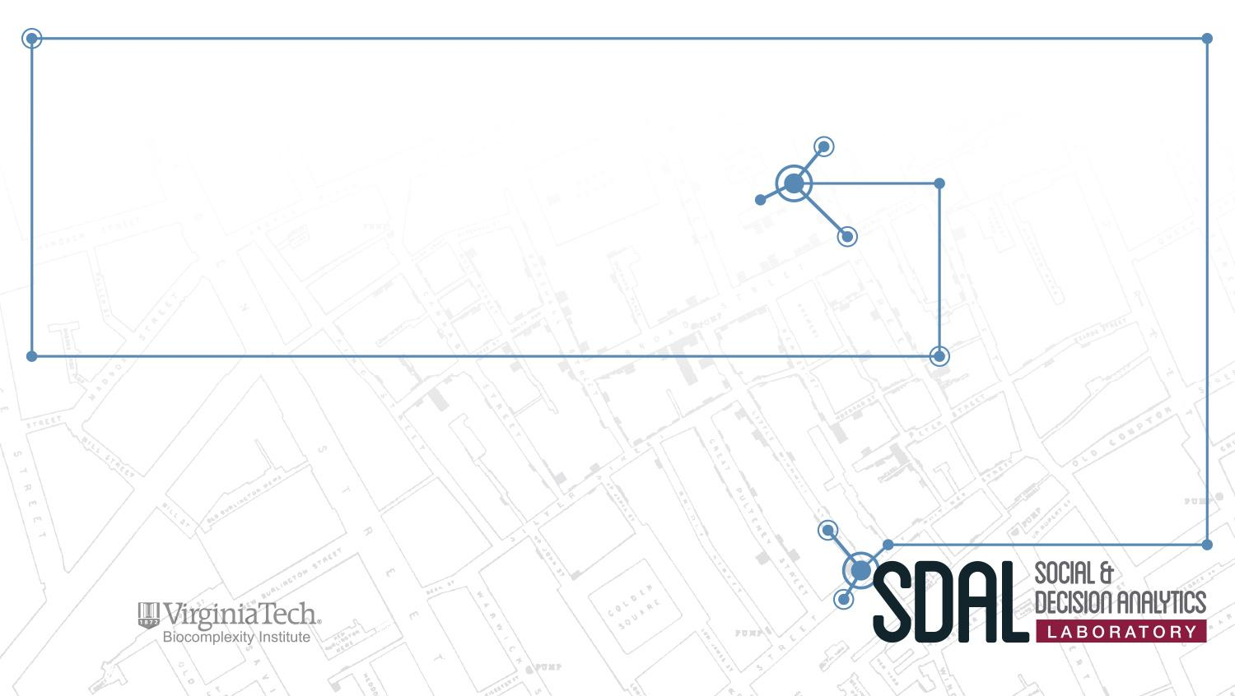

Measuring Open Source Software Innovation Project Update - Mar 15, 2018
Team: Matthew Evans, Ian Crandell, Gizem Korkmaz, and Stephanie Shipp
Sponsor: Carol Robbins, National Science Foundation (NSF)
National Center for Science and Engineering Statistics (NCSES)

Slide 2
Project Overview
Current NCSES and other economic indicators do not measure the value of goods and services that do not have market transactions
The goal is to test the feasibility and to develop methods to measure the impact and scope of open source software
This update meeting will focus on:
Universe of Open Source Software
Cost Estimation of R Packages
Notes:
i.e., they are not captured in surveys nor are in economics measures such as the Gross Domestic Product (GDP).

Slide 3
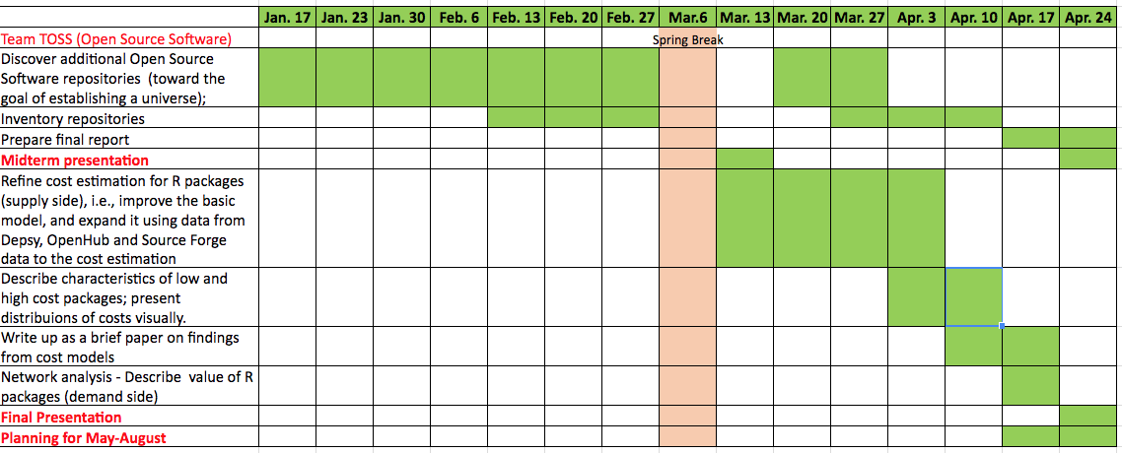
Timeline/Milestones

Slide 4
Universe of Open Source Software
Environments
Repositories
In a version control system, a repository is an on-disk structure which stores metadata for a set of files or directory structure. Different version control systems have they own way of storing data.
e.g., BitBucket, Github, Mantis Bug Tracker, Sourceforge, etc.
Version Control Software platforms
Also known as: version control, revision control and source control, which is the management of changes to documents, computer programs, large web sites, and other collections of information.
e.g., Git, CVS, Mercurial, Bitkeeper
Other Resources
IDE’s, continuous integration tools, bug tracking, project management
Notes:
Information on Repositories: https://en.wikipedia.org/wiki/Repository_(version_control)
Metadata = data on data
This is where the data is stored
Information on Databases:
Version Control Software https://en.wikipedia.org/wiki/Version_control
Version control = revision control = source control = is the management of changes to documents, computer programs, large web sites, and other collections of information
This is the protocol used to store the data

Slide 5
Repositories - Data Discovery
Finding Repositories
Initial searched for “Github alternatives”, “Source Code Repository Hosts”
Found articles for different repositories (60 total repositories)
Then googled for them by name
Link: Orange - closed project, Green - integrated project
Link | Number of Repositories Listed | Explanation | Data Published
Beebom.com | 7 | Article giving alternatives to Gitorious after it was purchased by GitLab | March 2015
blog.profitbricks.com | 45 | Article listing the top source code repositories w/ key features and costs | Dec. 2014
stackify.com | 50 | Article listing the top source code repositories w/ key features and costs | May 2017
bettertechtips.com | 6 | Article listing 6 top GitHub alternatives | Oct. 2017
toppersworld.com | 10 | Article listing the top 10 free GitHub alternative for private repositories | June 2014
alternativeto.net | 15 | Article listing alternatives to GitHub for all platform with any license | ~ 2015
technologyadvice.com | 9 | Article listing 9 GitHub alternatives | Dec. 2016
Notes:
These article give alternatives to GitHub for Source Code.
https://beebom.com/github-alternatives/
https://blog.profitbricks.com/top-source-code-repository-hosts/
https://stackify.com/source-code-repository-hosts/
https://www.bettertechtips.com/software/github-alternatives/
https://toppersworld.com/top-10-free-github-alternatives-for-private-repositories/
https://alternativeto.net/software/github/
http://technologyadvice.com/blog/information-technology/github-alternatives/

Slide 6
Repositories - Screening
Removed any project that was no longer open/active
Categorized Repos into Open Source, Enterprise and Other
20 Enterprise
18 Open Source
2 Other
Generally took all the Open Source repos and none of the Enterprise with the exception of
Open Source not being a repository or run through GitHub
Large organizations like Amazon or Google
Started as Open Source and was purchased
Link: Green - yes, Red - no

Slide 7
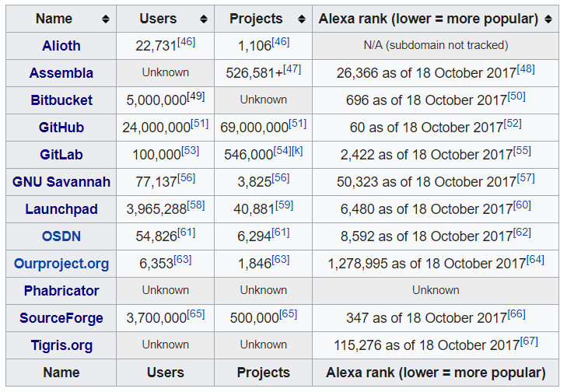
Repositories - Screening
https://en.wikipedia.org/wiki/Comparison_of_source_code_hosting_facilities
Notes:
Found this as I was looking for the different repositories information
And has a lot of good data to compare repositories
https://en.wikipedia.org/wiki/Comparison_of_source_code_hosting_facilities

Slide 8
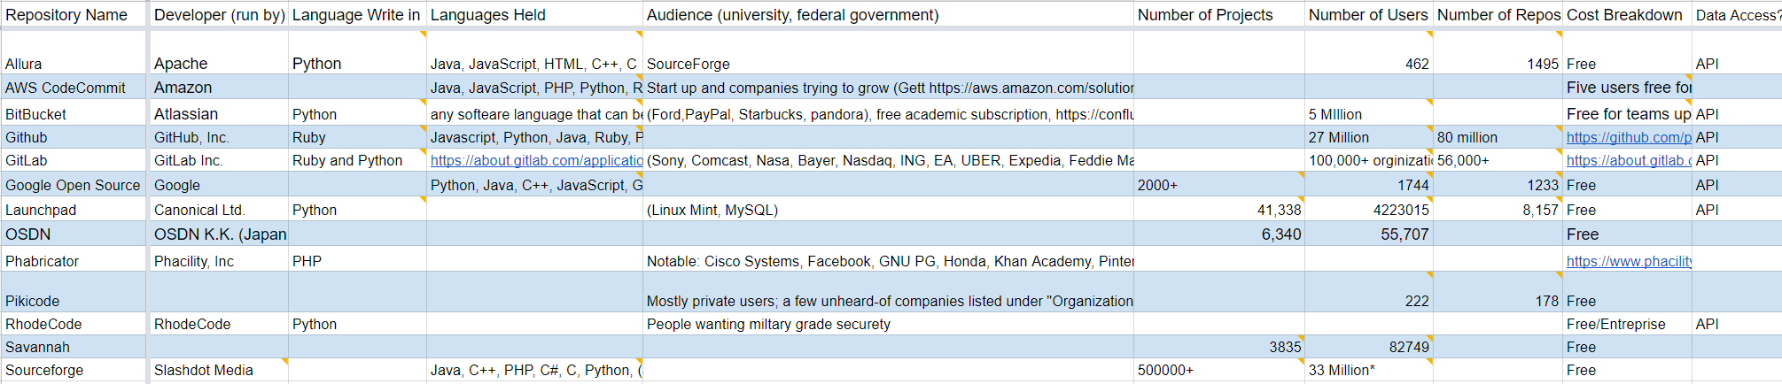
Repositories - Screening
https://docs.google.com/spreadsheets/d/17ooH9SXbR8Kg_ugVZPqyo4KfOk28SyjaGoPOKP1wjuU/edit#gid=738409776
Notes:
This currently (4/5/2018) all the information that we could find on the given repositories, there are more column on google sheet

Slide 9
Version Control Software Platforms
Repository Models
Describes the relationship between various copies of the source repository
Client-server - users access a master repository via a client, usually local machines only hold working copies of a project tree
CVS, ClearCase, CVSNT
Distributed - repositories act as peers, and users typically have a local repository with version history available, in addition to their working copies
Darcs, Git, Bitkeeper
Others
Local, Shared Folder
Notes:
https://en.wikipedia.org/wiki/Comparison_of_version_control_software

Slide 10
Version Control Software Platforms
Concurrency Model
Describes how changes to working copy are managed to prevent simultaneous edits from causing nonsensical data in the repository
Lock - only one user can edit at a time (not popular)
PVCS, Source Code Control System
Merge - users may edit files freely, but are informed of possible conflicts upon checking their changes into the repository
GNU Bazaar, BitKeeper, CVS, Git, Mercurial
Notes:
https://en.wikipedia.org/wiki/Comparison_of_version_control_software

Slide 11
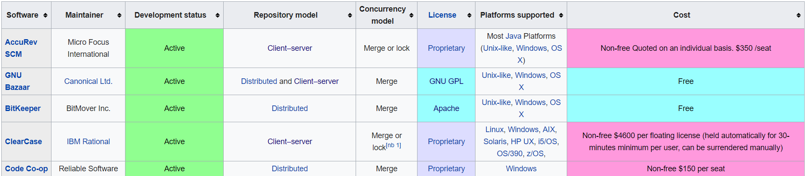
Version Control Software Platforms
Discovery
There are 36 total version control softwares and 29 active (wikipedia)
15 are open source
Apache - 3
GNU GPL - 10
BSD License (free software license, ex. MIT License) - 2
Notes:
https://en.wikipedia.org/wiki/Comparison_of_version_control_software

Slide 12
Other Resources
Continuous Integration
The practice of merging all developer working copies to a shared mainline several times a day. (helps prevent integration issues)
Jenkins
GitLab CI
Integrated Development Environment (IDE)
Software suite that consolidates the basic tools developers need to write and test software. (normally include text (‘code”) editor, compiler, debugger and GPI)
Android Studio
OpenDataKit
OpenStack
Linux
Software that keeps track of reported software bugs in software development projects.
Mantis Bug Tracker
Notes:
https://en.wikipedia.org/wiki/Continuous_integration
A Version control system (VCS) helps you create meaningful sets of changes to the source code of your project, send those changes somewhere central so that you keep the history of changes safe, and makes it easy for other people in your team to get the history of changes in order to collaborate with you.
A continuous integration (CI) system helps you build, or test or both, the source code of your project to see if it works without any errors, every time you make a meaningful set of changes.
https://www.quora.com/What-is-the-difference-between-continous-integration-tool-and-version-control-tool-e-g-Jenkin-Maven-and-GitHUB-SVN
IDE: https://docs.google.com/document/d/1SV_YXL66ki3LgxwzOEA97lnSEdKm3DFrq6ahf82Prns/edit
https://en.wikipedia.org/wiki/Bug_tracking_system
https://en.wikipedia.org/wiki/Comparison_of_issue-tracking_systems
https://code-maze.com/top-8-continuous-integration-tools/
https://about.gitlab.com/2017/09/27/gitlab-leader-continuous-integration-forrester-wave/
https://docs.google.com/document/d/1SV_YXL66ki3LgxwzOEA97lnSEdKm3DFrq6ahf82Prns/edit
https://docs.google.com/document/d/13owAwScixsBGxJGTc_QyPdHuj-T7RlbOzGvsMfi_D4w/edit
Openhub
Stack overflow
https://www.quora.com/What-is-the-difference-between-continous-integration-tool-and-version-control-tool-e-g-Jenkin-Maven-and-GitHUB-SVN
https://en.wikipedia.org/wiki/Comparison_of_source_code_hosting_facilities

Slide 13
Estimating the Cost of R Packages

Slide 14
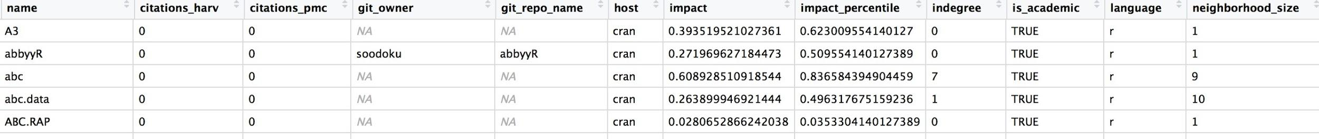
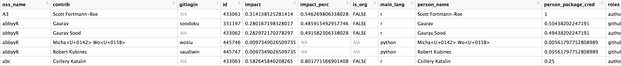
Data Sources: Depsy.org
Depsy.org
9,810 R packages collected from Depsy (last update in Sept. 2015) with 24,000+ affiliated contributors
Descriptive metrics on packages: contributors, number of commits, number of downloads, number of citations, reuse/dependency
Metrics on developers: number of packages contributing to R & Python (experience), impact, and citations

Slide 15
Data Sources: Openhub
Openhub
Scraped to obtain lines of code (LOC)
Dropped any packages from Depsy that was not on Openhub
Obtained LOC for 1,124 packages and 2,905 contributors

Slide 16
Data Sources: BLS
Occupation Employment Survey from the Bureau of Labor Statistics
Used wages from 2016
Occupations: computer programmers, software developers (application, system software, web developers)
Took averages from each bin to assign annual wages to three groups based on experience (computed from Depsy):
Low ($88,277)
Medium ($114,000)
High ($142,680)

Slide 17
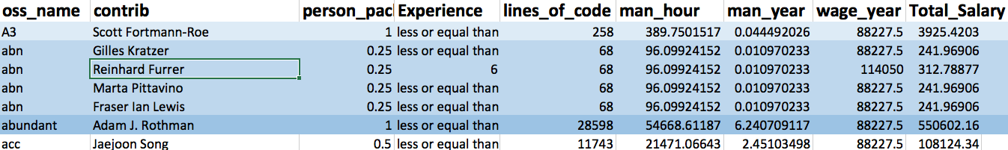
Cost Estimation
The package cost was calculated as follows:
From the basic COCOMO estimation formula:
Effort = person_months = 2.4 * KLOC ^1.05
Package cost = sum(total_person_year * wage_year)

Slide 18
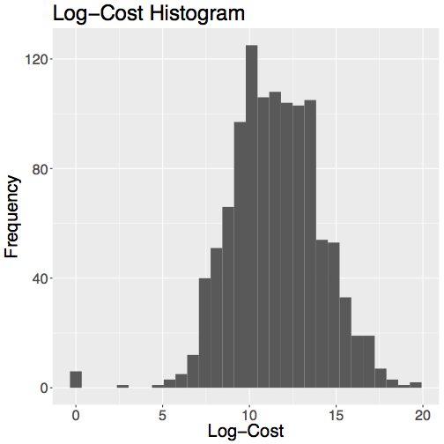
Cost Estimation
Statistic | Package | Value
Maximum | pear | $320.7 million
Minimum | dummy | $16
Median | NA | $1.83 million
Mean | NA | $2.02 million
Package Name | Lines (Thou) | Package Cost (Mil) | Main Contributors
pear | 10,005 | $320.7 | 2
EMP | 11,242 | $316.3 | 3
MESS | 4,373 | $151.7 | 1
MAd | 2,998 | $78.9 | 2
fractal | 2,654 | $69.4 | 2
For the most part, the log of the package’s cost follow a bell-shaped distribution.

Slide 19
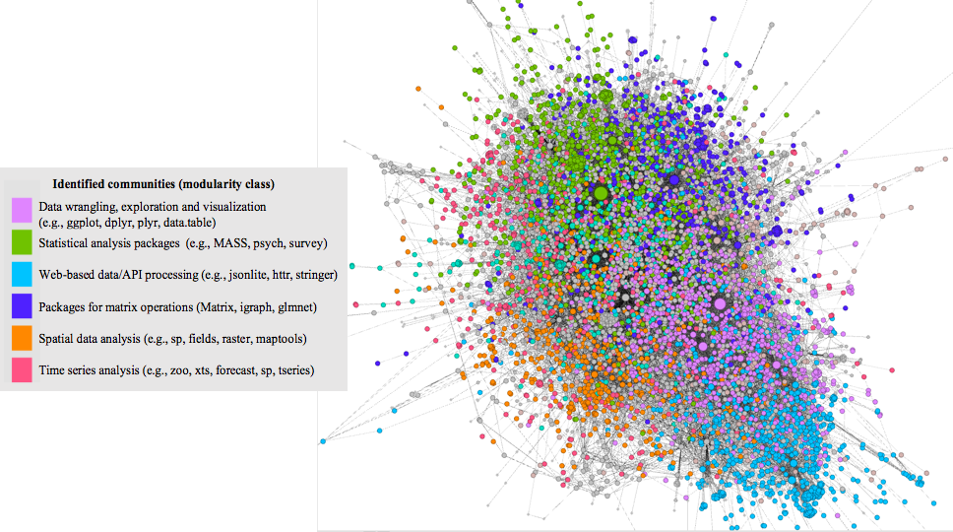
Dependency Network
The dependency network of R packages where a directed edge i → j indicates that the package j requires i to be installed to function.
Full Network Characteristics:
7,389 nodes
20,235 directed edges
Average indegree = outdegree = 2.74
56 weakly connected components
Largest component has 7,261 packages (shown in the figure)
Remaining components include 2 to 4 packages (mean 2.33)

Slide 20
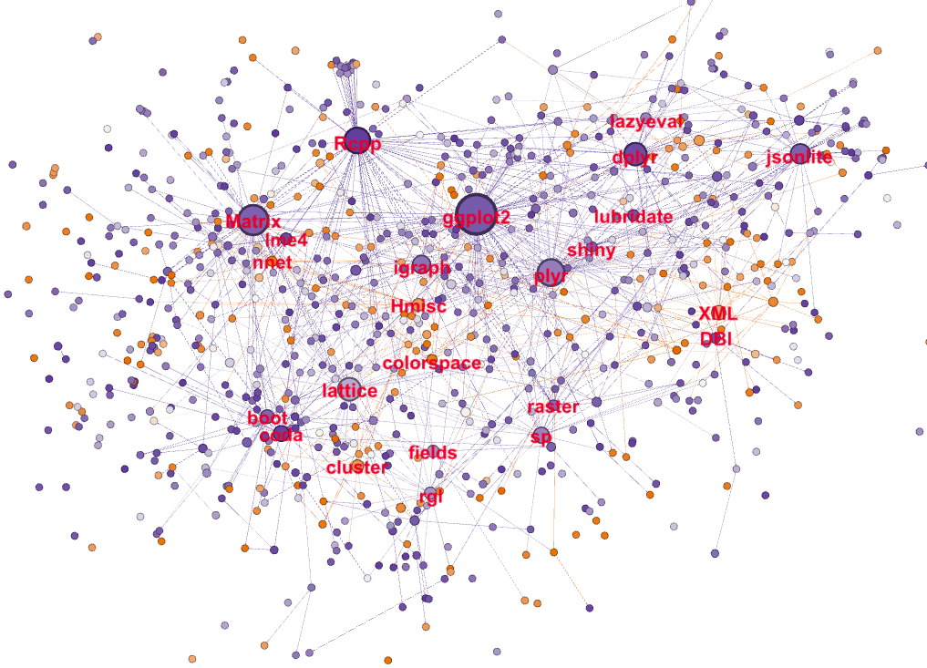
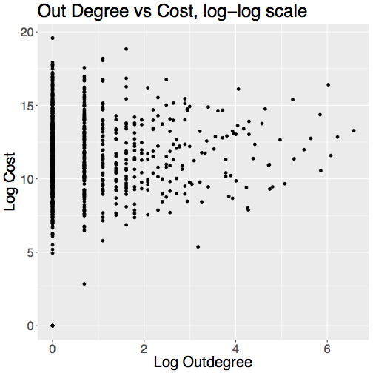
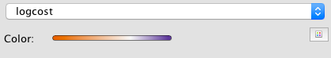
Dependency Network
Cost and Outdegree
The subgraph has 1,124 nodes and 920 edges
The colors indicate the logcost and the size of the node corresponds to outdegree
Because both outdegree and cost are right-skewed, we examined log-transformed versions.
As outdegree increases, cost shows little change.
corr = 0.053

Slide 21
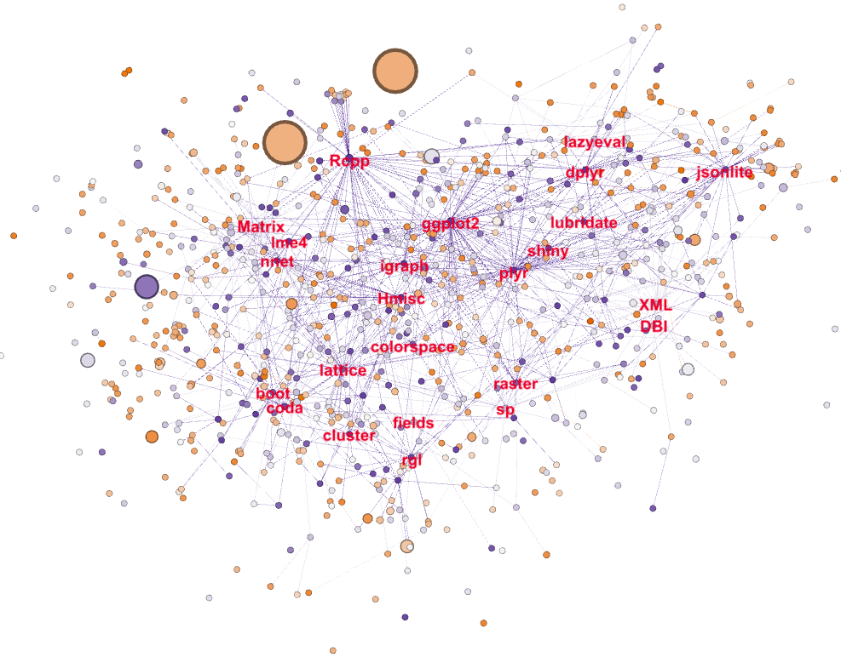
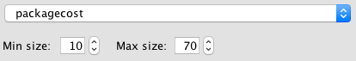
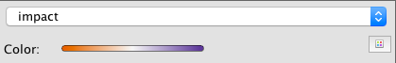
Dependency Network
Cost and Impact
pear
Impact score is calculated as the average of these three:
downloads from software repositories
software reuse via reverse dependencies
literature reuse (citations)
The colors indicate the logcost and the size of the node corresponds to impact score
We do not find any correlation
EMP
MESS

Slide 22
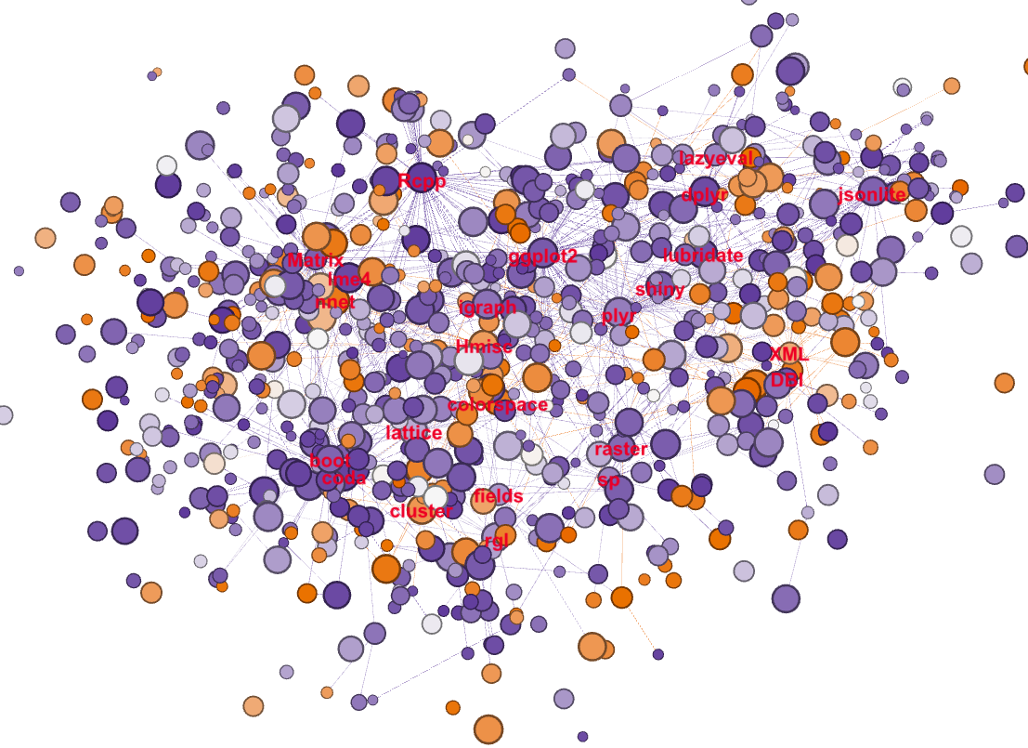
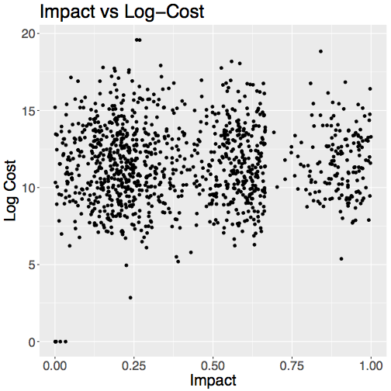
Dependency Network
Cost and Impact
corr = 0.047

Slide 23
Next Steps - discussion
OSS Universe
Repository and database inventory
Enhance the cost estimation model
Contributor impact
Nominal development time
others
Demand side
downloads, citations, dependencies

Slide 24
Old: Project Update
Dec 2017

Slide 25
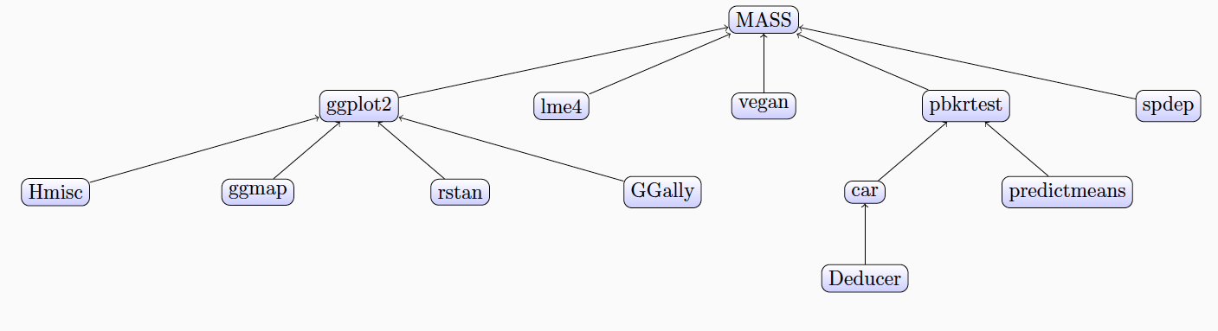
Project Overview
Current NCSES and other economic indicators do not measure the value of goods and services that do not have market transactions
The goal is to test the feasibility and to develop methods to measure the impact and scope of open source software
Notes:
i.e., they are not captured in surveys nor are in economics measures such as the Gross Domestic Product (GDP).

Slide 26
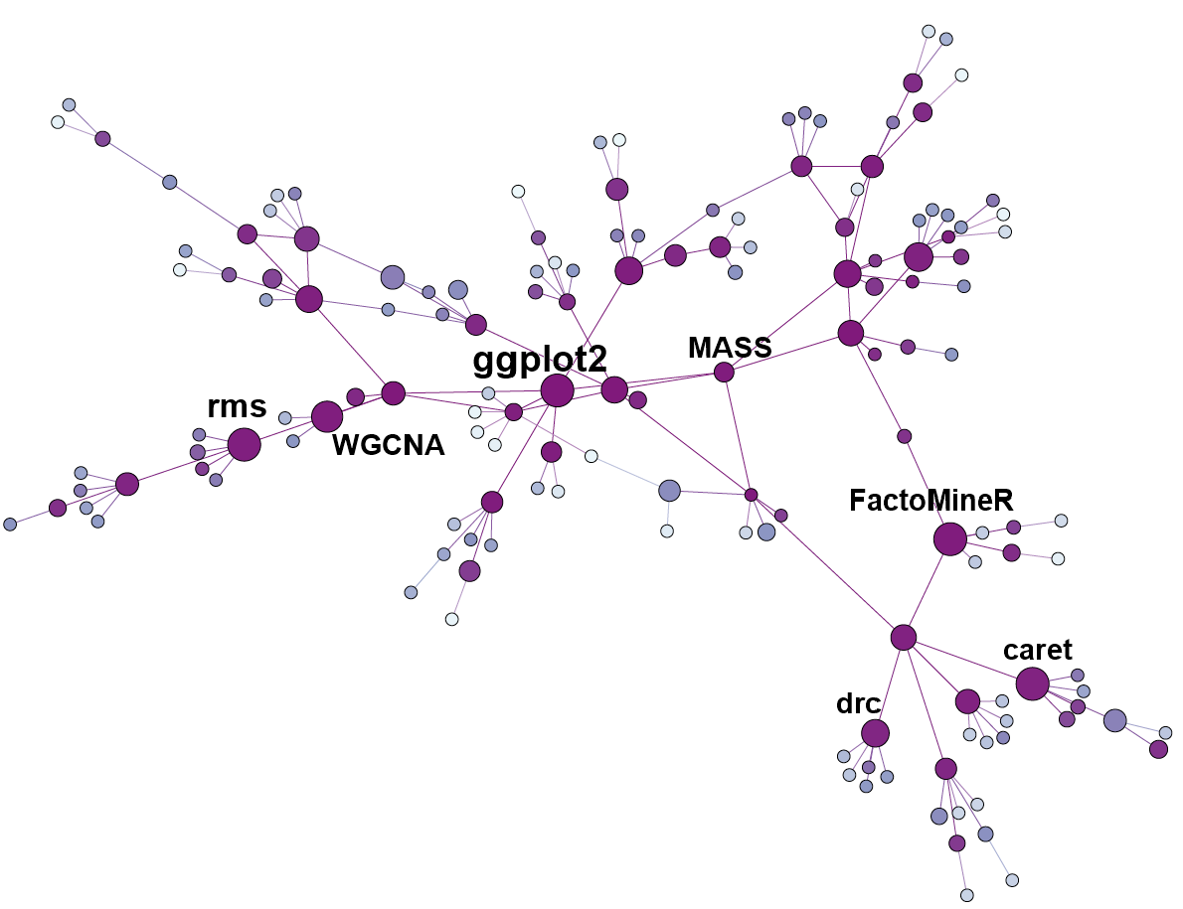
Project Goals & Deliverables
Building on research conducted during Summer 2016, Fall 2016, and Spring 2017
Understanding existing cost/value models for private software
Adapting to open source software
Data Mining
Develop methods to estimate cost
Modeling and network analysis

Slide 27
Review of Cost Models
COCOMO II
Was derived from COCOMO 81 which was created by Dr. Barry Boehm in 1981
Develop by USC in 2000
Model incorporated key algorithms into one: Software Scale Drives; Software Cost Drivers; Product Drivers; Maintenance
SLIM
Developed in 1978 by Putnam to determine the time and effort required to complete a project of a certain size
Simplest model to follow and calibrate
SEER SEM
Algorithmic project management software application designed to estimate, plan and monitor the effort and resources required for any type of software development and/or maintenance project.
Other proprietary versions(only part of the algorithm are published)

Slide 28
Cost Factors from Models
Scale Drivers
Evaluation of Economies and Diseconomies as Team Dynamics
Cost Drivers
Product attributes
Hardware attributes
Personnel attributes
Project attributes

Slide 29
Cost Drivers
COCOMO II Factor | SEER-SEM Factor(s) | Putnam SLIM
PRODUCT ATTRIBUTES
Required Software Reliability | Specification Level - Reliability | Required Reliability
Data Base Size | NONE | NONE
Product Complexity | - Complexity (Staffing) - Application Class Complexity | Complexity
Required Reusability | - Reusability Level Required - Software Impacted by Reuse | Reuse
Documentation Match to Lifecycle Needs | NONE | NONE
NONE | NONE | Language
NONE | NONE | Type
PLATFORM ATTRIBUTES
Execution Time Constraint | Time Constraints | Time Constraint
Main Storage Constraint | Memory Constraints | Storage Constraint
Platform Volatility | - Target System Volatility - Host System Volatility | NONE

Slide 30
Cost Drivers
COCOMO II Factor | SEER-SEM Factor(s) | Putnam SLIM
PERSONNEL ATTRIBUTES
Analyst Capability | Analyst Capability | NONE
Programmer Capability | Programmer Capability | Personnel Capability
Personnel Continuity | NONE | NONE
Application Experience | Application Experience | Application Experience
Platform Experience | - Development System Experience | NONE
Language and Toolset Experience | - Target System Experience Programmer’s Language Experience | Language Experience
NONE | NONE | Hardware Experience
PROJECT ATTRIBUTES
Use of Software Tools | Software Tool Use | Tools and Technics
Multi-site Development | Multiple Site Development | NONE
Required Development Schedule | NONE | Schedule
NONE | NONE | Computer Access

Slide 31
Data Sources
Depsy
Database providing an analysis on different R (CRAN), and Python packages
Gives us information like contributors, number of downloads, etc…
Openhub
Database like Depsy, but much larger that provides more information about most OSS
Occupation Employment Survey from the Bureau of Labor Statistics
Principal fact-finding agency for the U.S. government in the field of labor economics and statistics and serves as principal agency of the U.S. Federal Statistical System
Looking at different occupations related to software development to try and estimate a wage

Slide 32
Data Sources: Depsy.org
Depsy.org
Detailed information of contributors and R packages are provided
Contributors' information
R packages' information
(from September 2015)
23867 entries including 9810 R packages and 13883 contributors

Slide 33
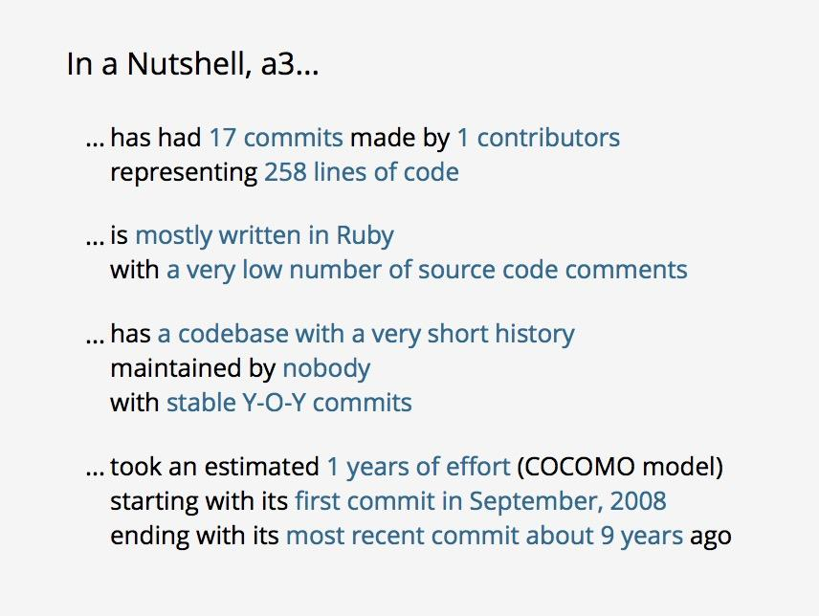
Data Sources: Openhub
Openhub
Scraping missing fields of data(lines of codes)
Data Scraped and Sorted

Slide 34
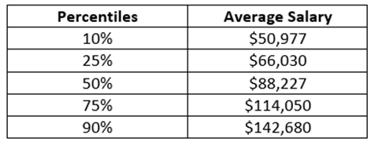
Data Sources: BLS
Data from 2016
Percentiles (10%, 25%, 50%, 75%, 90%)
Occupations: computer programmers, software developers application, software developers system software, web developers
Took average from all four for each percentile

Slide 35
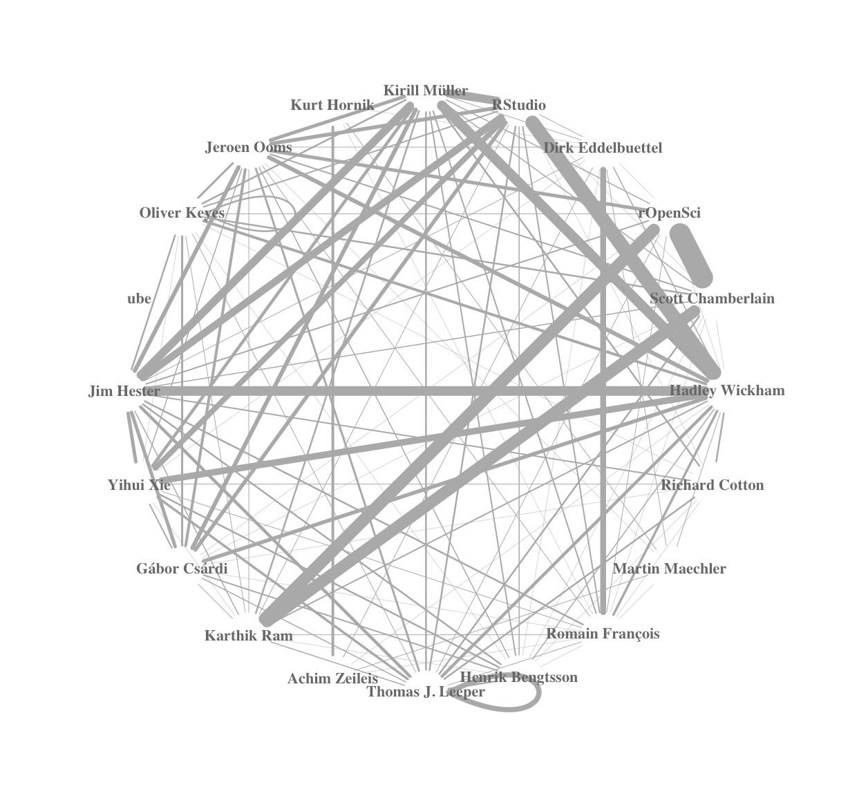
Initial Findings
Dropped any packages from Depsy that was not on Openhub
1119 packages
2905 contributors
man_hour = 2.4 * SLOC ^1.05
Cost = sum(total_man_year * wage_year)

Slide 36
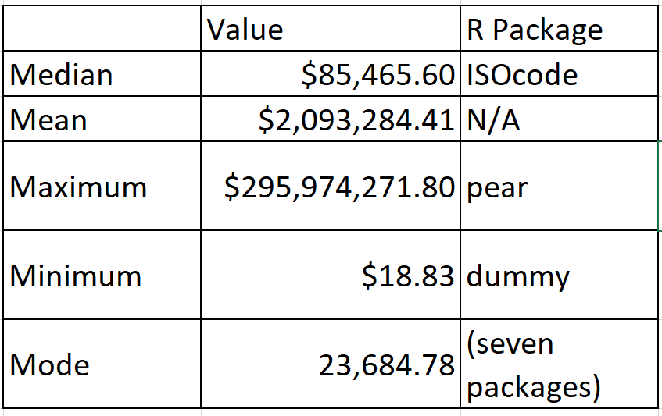
Initial Findings
oss_name | lines_of_code | Total_cost | Number_of_Main_Contributors
pear | 10005591 | 295974271.8 | 2
EMP | 11242262 | 291797694.5 | 3
MESS | 4373306 | 139967480.3 | 1
MAd | 2998245 | 72844361.8 | 2
fractal | 2653875 | 64085526.29 | 2
hive | 1567256 | 59613076.35 | 2
blender | 1827385 | 55988436.98 | 1
INSPIRE | 2071565 | 49408191.98 | 1
geotools | 1954032 | 46469042.51 | 1
dataone | 1517062 | 43085370.18 | 17
h2o | 36 | 496.37 | 3
dyn | 34 | 467.45 | 1
convey | 31 | 462.68 | 5
SPIn | 30 | 409.89 | 1
cccp | 21 | 301.17 | 5
AtelieR | 17 | 225.77 | 1
tm | 11 | 209.1 | 4
mongolite | 9 | 165.32 | 4
cope | 10 | 129.33 | 1
dummy | 1 | 18.83 | 3

Slide 37
Next Steps - discussion
Now that we have all the data we need including a formula for finding cost, we need determine what kind of regression analysis is necessary in order to find a correlation between the calculated cost and independent variables
A problem we have at the moment however is the data isn’t cleaned to the point where we can just take each cell for what it is and analyze it
Once we’ve acknowledged and analyzed correlations, we’ll begin making the model

Slide 38
Links to Data
Cleaned Data - https://docs.google.com/a/vt.edu/spreadsheets/d/1UQPnbVaur8j6yfq_nKnrfatEKDlIPc9teaJP5DrNv8o/edit?usp=drive_web
Summary -
https://docs.google.com/spreadsheets/d/1ViwRJ8m_tW4iI_71fapojsiBtg5SfCw3bMqnpTFIxR0/edit

Slide 39
Appendix

Slide 40
https://pdfs.semanticscholar.org/0fc2/259f539200f92e791237a1099fe91887b746.pdf
http://csse.usc.edu/afcaa/manual_draft/Cost%20Estimation%20Models.pdf
http://sunset.usc.edu/TECHRPTS/2008/usc-csse-2008-816/usc-csse-2008-816.pdf
http://csse.usc.edu/TECHRPTS/PhD_Dissertations/files/ChenZhihao_Dissertation.pdf
http://sunset.usc.edu/research/COCOMOII/Docs/modelman.pdf
http://csse.usc.edu/csse/research/cocomoii/cocomo2000.0/cii_modelman2000.0.pdf
http://regulationbodyofknowledge.org/faq/telecommunication-regulation-interconnection/what-are-common-cost-models-used-for-determining-interconnection-tariffs-and-how-do-they-deal-with-common-costs/
http://csse.usc.edu/csse/research/cocomoii/cocomo_main.html
http://csse.usc.edu/TECHRPTS/1984/usccse84-500/usccse84-500s.pdf
https://www.youtube.com/watch?v=CgTEoekNYRs

